Slide 1
Fracture of Lattice Metamaterials
By: Helder Rebelo

Slide 2
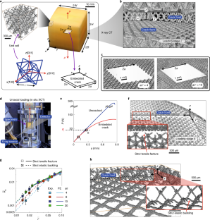
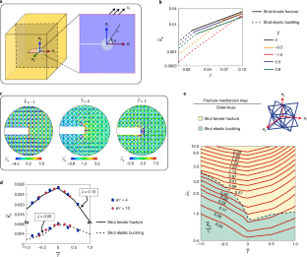
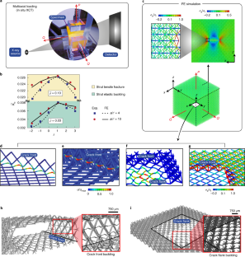
3D Toughness of Mechanical Metamaterials (Nature Materials, 2022) ~ Summary
K alone is insufficient in architected lattices; a two‑parameter description using (K, T) with crack‑size/load‑path calibration captures failure across stretching vs buckling regimes.

Slide 3
Bridge to 2D: What carries over? What changes?
K‑dominant fields persist in planar beam‑lattices, but topology (connectivity) dictates local fields and failure sites.
T‑stress sensitivity remains important for apparent K_{c} and mechanism switching (tension fracture ↔ elastic buckling).
Scaling with relative density (ρ̄): triangular ≈ ρ̄; hexagonal (bending) ≈ ρ̄²; kagome often ≈ ρ̄^{1/2} to ρ̄, depending on failure criterion.
Specimens: center‑cracked plates & boundary‑layer domains avoid boundary artifacts; embedded flaws over through‑thickness when possible.
Fleck & Qiu (2007); Romijn & Fleck (2007); Tankasala et al. (2015); Omidi & St‑Pierre (2023).

Slide 4
2D Fracture Modelling & Approaches That Work
Boundary‑Layer (BL) Method
Impose analytical u(r,θ) for target K_{I}/K_{II} (and optional T) on a circular ring of perimeter nodes.
Increase K until first local criterion met → K_{c}; sweep mixity to generate a mixed‑mode envelope.
Fleck & Qiu, 2007; Tankasala et al., 2015.
Beam‑Lattice FE + Progressive Failure
Model struts with Euler/Timoshenko beams; brittle (ε_{f}) or plastic (J2) cell‑wall law.
Embedded pre‑crack; BL or far‑field traction BCs; element removal/softening for crack growth & R curves.
Hsieh et al., 2020; Omidi & St‑Pierre, 2023.
Analytical / Reduced Models
Square/triangular/kagome beam networks: closed form relations for K_{c}(ρ̄) and imperfection sensitivity.
Fuse‑network analogs for antiplane fracture & size effects.
Romijn & Fleck, 2007; Nguyen 2024 (fuse nets).

Slide 5
What 2D Studies Consistently Find
Topology matters: Kagome & demi‑regular can outperform triangular under Mode II; triangular excels in Mode I for stretching dominated structures.
Scaling: K̄_{c} ≡ K_{c}/(σ_{f}√ℓ) often follows A·ρ̄ⁿ with n≈1 (triangular), n≈2 (hex), n ≈ ½–1 (kagome/demi‑regular).
Initiation site: can be off the crack plane (kagome) due to elastic blunting regions extending O(10ℓ).
Mixed‑mode envelopes: BL studies show topology‑dependent envelopes (near‑circular vs piecewise) and strong T‑stress effects.
Fleck & Qiu, 2007; Romijn & Fleck, 2007; Tankasala et al., 2015; Omidi & St‑Pierre, 2023.

Slide 6
Setup & Boundary Conditions (Omidi & St-Pierre, 2023)
Goal: predict where the crack will propagate next by finding the first failing strut under a clean near-tip field.
Model: 2D beam-lattice of demi-regular topologies; unit-cell size ℓ vary relative density ρ​ by changing strut thickness t at fixed ℓ. Crack is a notch along x with the tip at the origin; crack faces are traction-free.
Domain & BCs: use a boundary-layer (BL) domain (big enough that the outer boundary doesn’t contaminate the tip). Prescribe the LEFM Mode I/II displacement field on the outer ring nodes: choose a mixite ψ=tan^−1(KII/KI) and ramp the amplitude K. This reproduces the near-tip solution inside the lattice.
Elements & material: Euler/Timoshenko beam elements; elastic-brittle struts with tensile strength (or failure strain). Local mesh refinement near the crack tip.

Slide 7
Setup & Boundary Conditions (Omidi & St-Pierre, 2023) Cont.
Load ramp & criterion: increase K at fixed ψ. After each increment, compute strut resultants; when any strut first reaches the strength criterion, record that increment as Kc​ and record that element’s location this is the predicted next tip (initiation site).
Mixed-mode envelope: repeat across ψ∈[0∘,90∘] to build Kc(ψ). Annotate each envelope segment by the initiation site (on-plane vs off-plane). These labels map where the crack is expected to propagate from under each mixite.
Scope & extensions: this procedure targets initiation (first failure). For R-curves / growth, extend with progressive element removal/softening under the same BL setup.

Slide 8
References
Shaikeea AJD et al., Nature Materials (2022): article
Fleck NA & Qiu X., JMPS (2007): pdf
Romijn NER & Fleck NA, JMPS (2007): pdf
Tankasala HC, Deshpande VS, Fleck NA, J. Appl. Mech. (2015): pdf
Omidi M & St‑Pierre L, Scripta Materialia (2023, CC BY): open page
Montemayor LC et al., Sci. Reports (2016): article
Gao Z et al., Nat. Communications (2024): article

